Slide 2

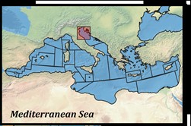
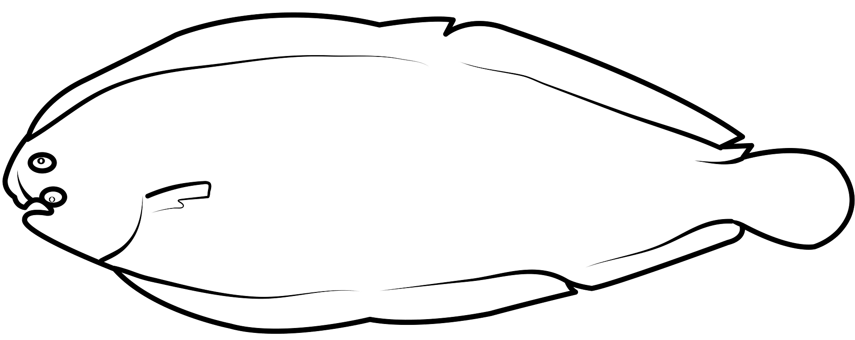
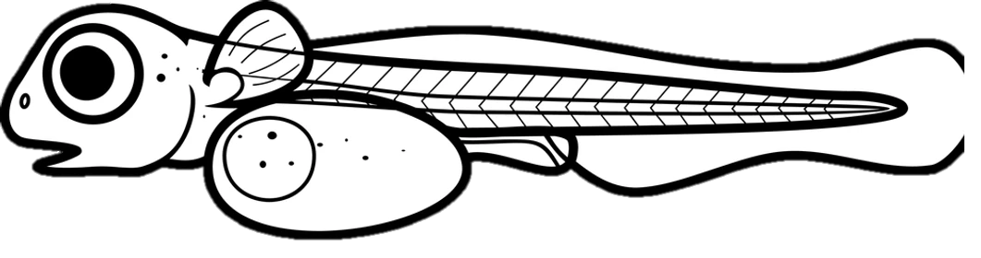

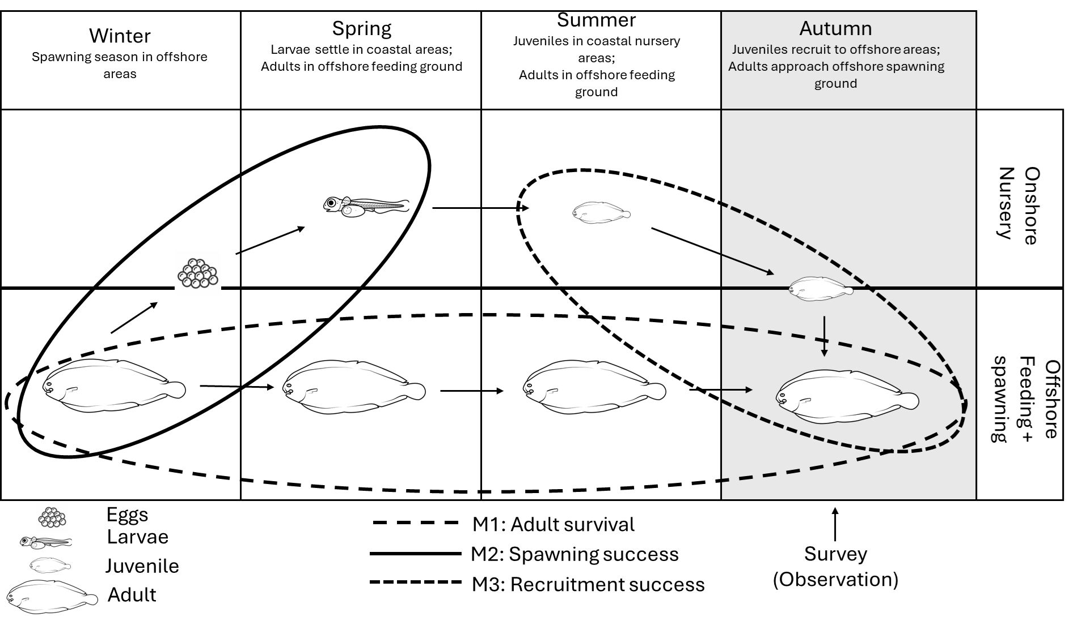
Nursery

Slide 3
Spring
Larvae settle in coastal areas;
Adults in offshore feeding ground
Summer
Juveniles in coastal nursery areas;
Adults in offshore feeding ground
Autumn
Juveniles recruit to offshore areas;
Adults approach offshore spawning ground
Winter
Spawning season in offshore areas
Onshore
Nursery
Offshore
Feeding + spawning
Eggs
M1: Adult survival
Larvae
Juvenile
M2: Spawning success
Survey (Observation)
Adult
M3: Recruitment success

Slide 4


Slide 5
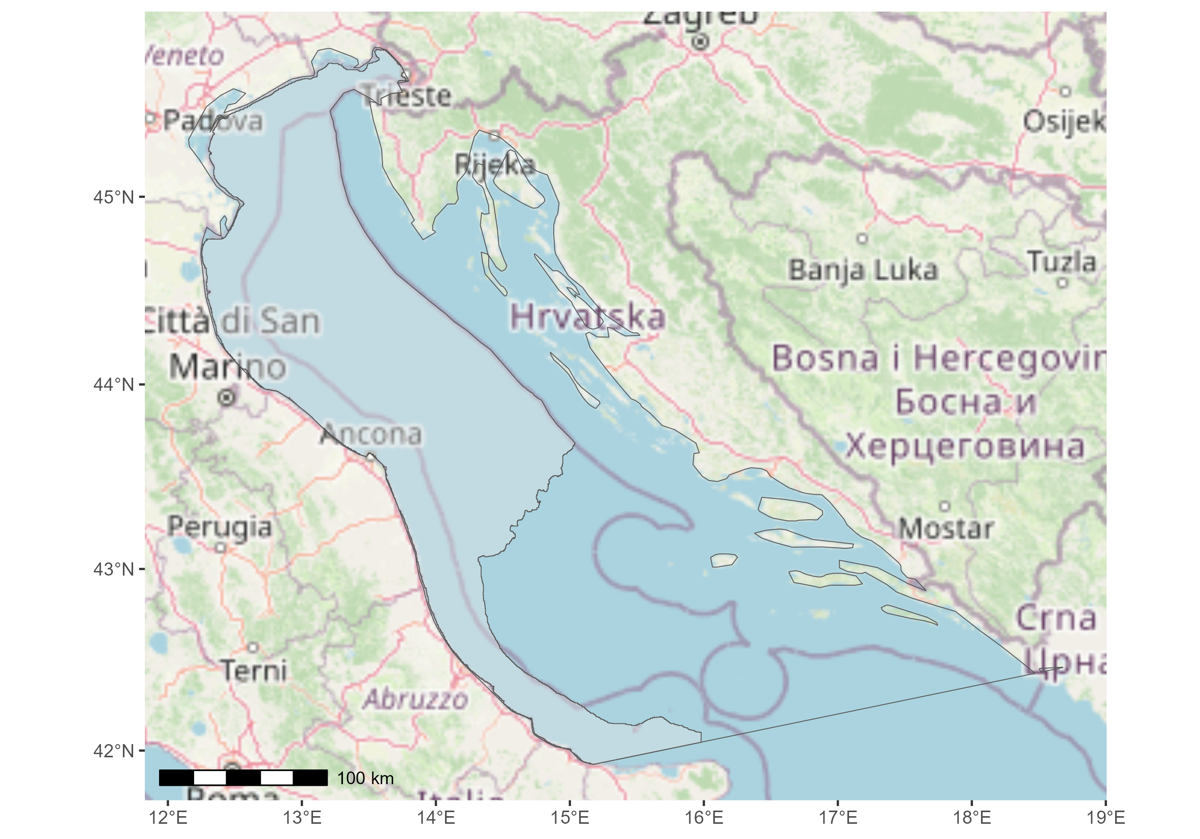
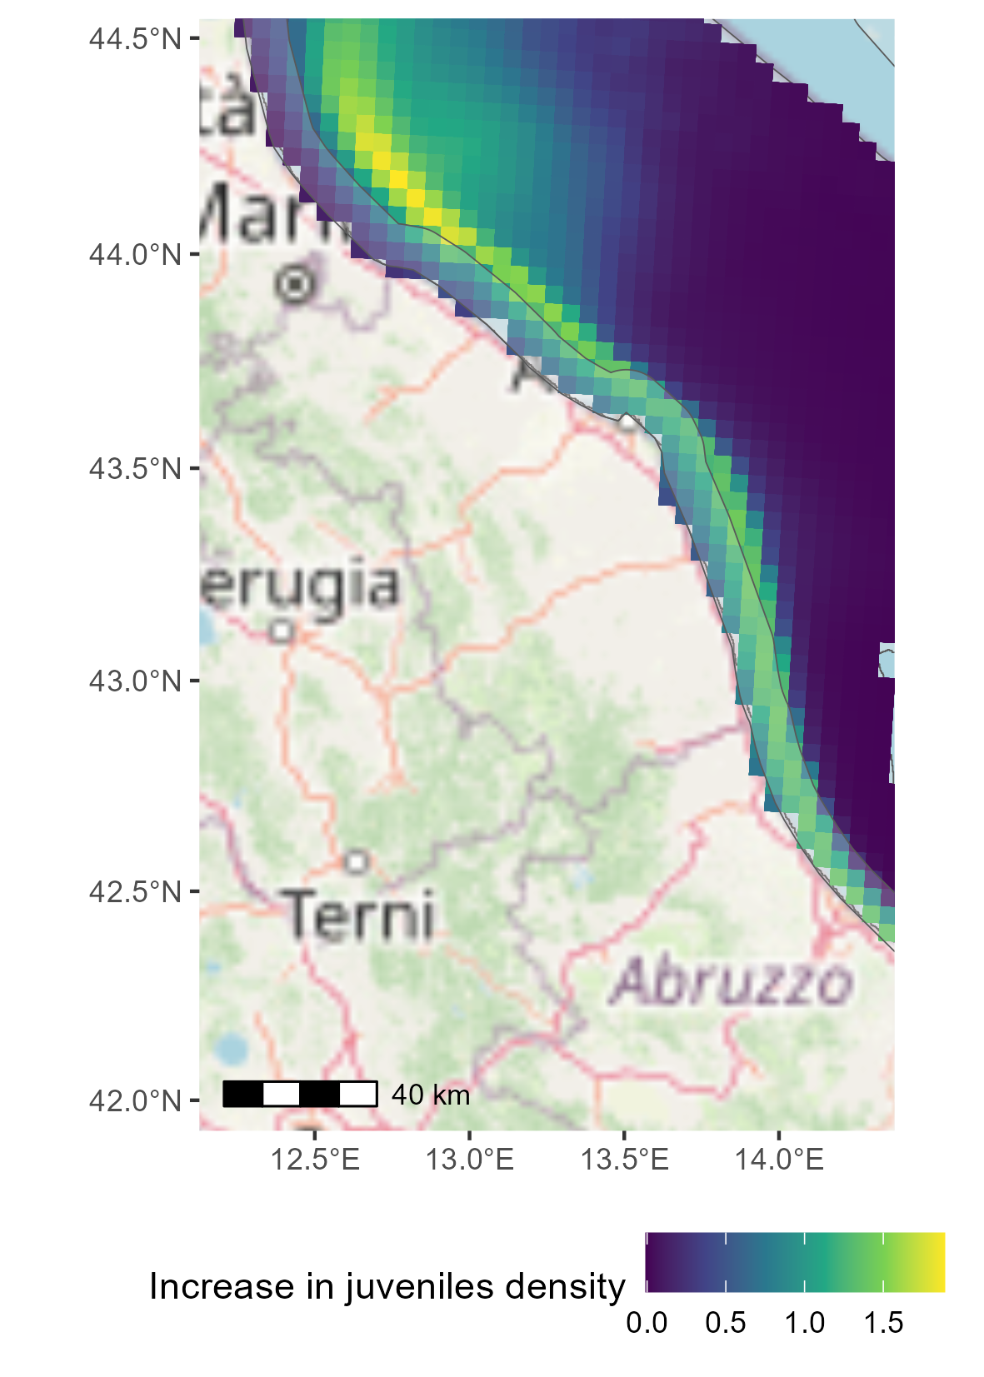
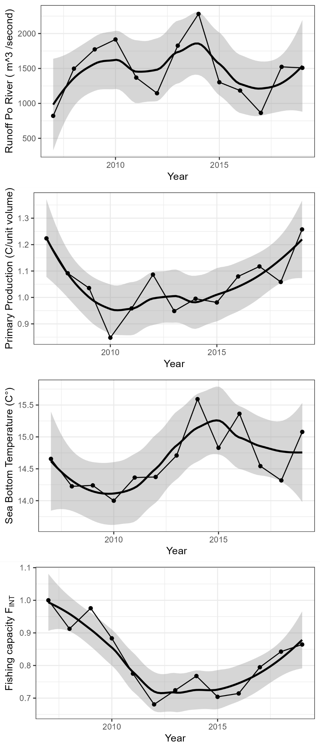
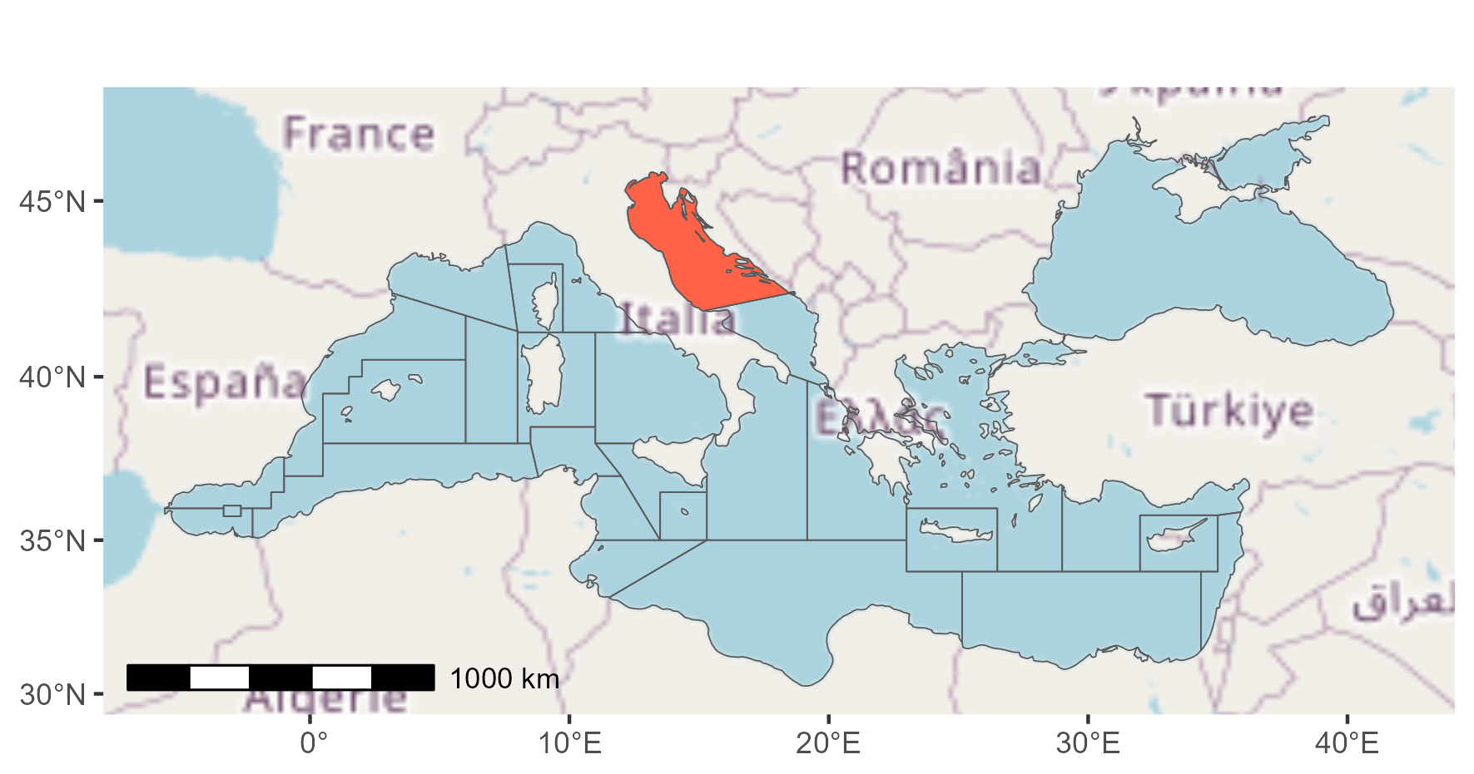
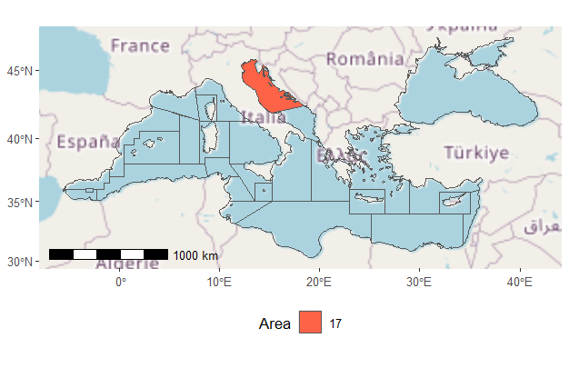
a)
a)
c)
b)
Nursery
d)
Spatial protection (6NM)
g)
e)
f)

Slide 6
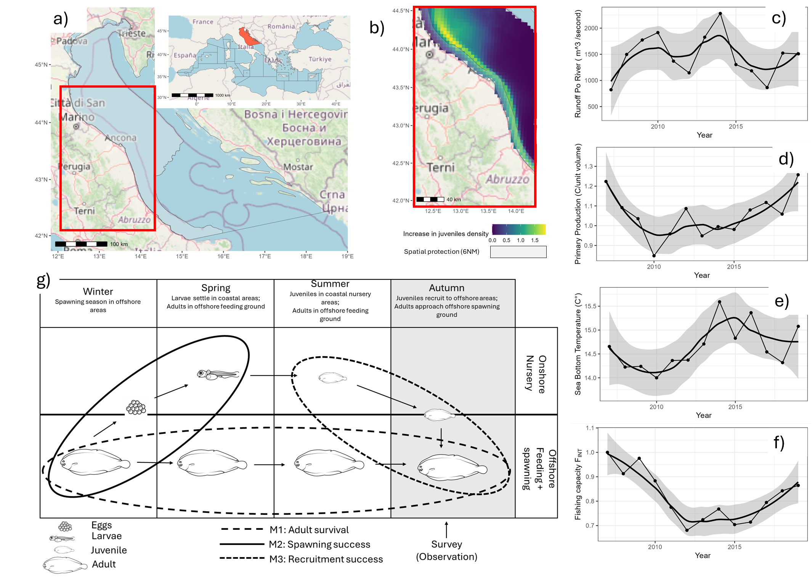

Slide 7
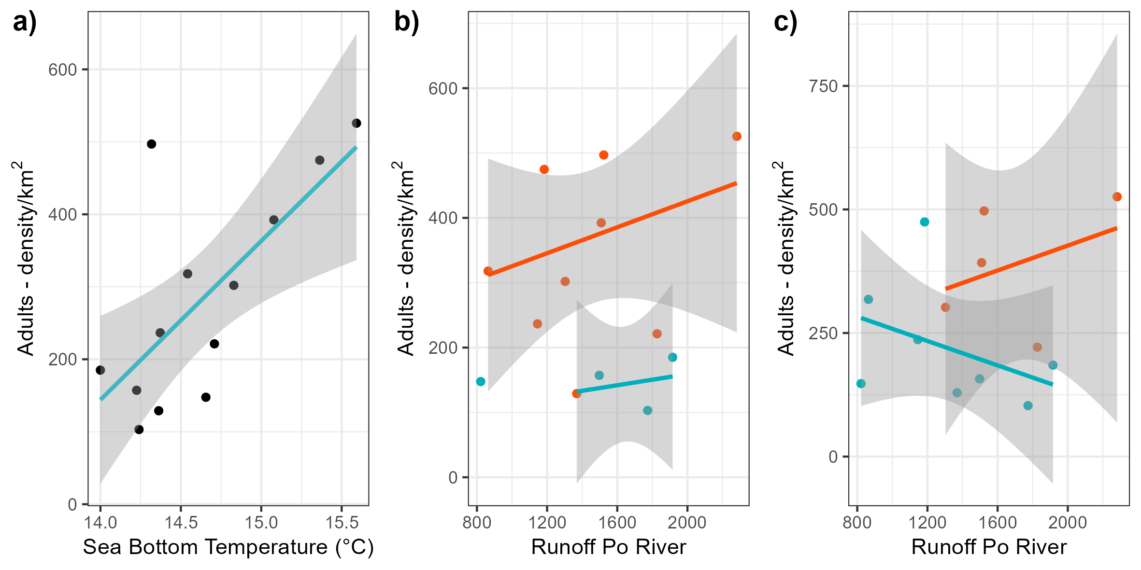

High
High
Low
Low

Slide 8
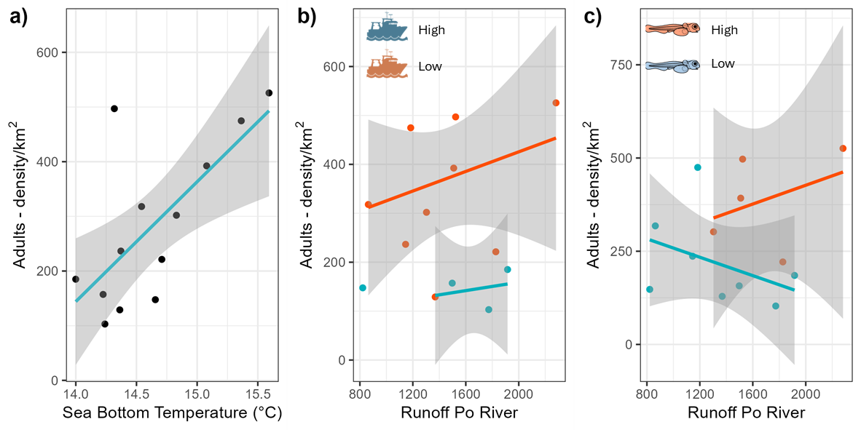

Slide 9
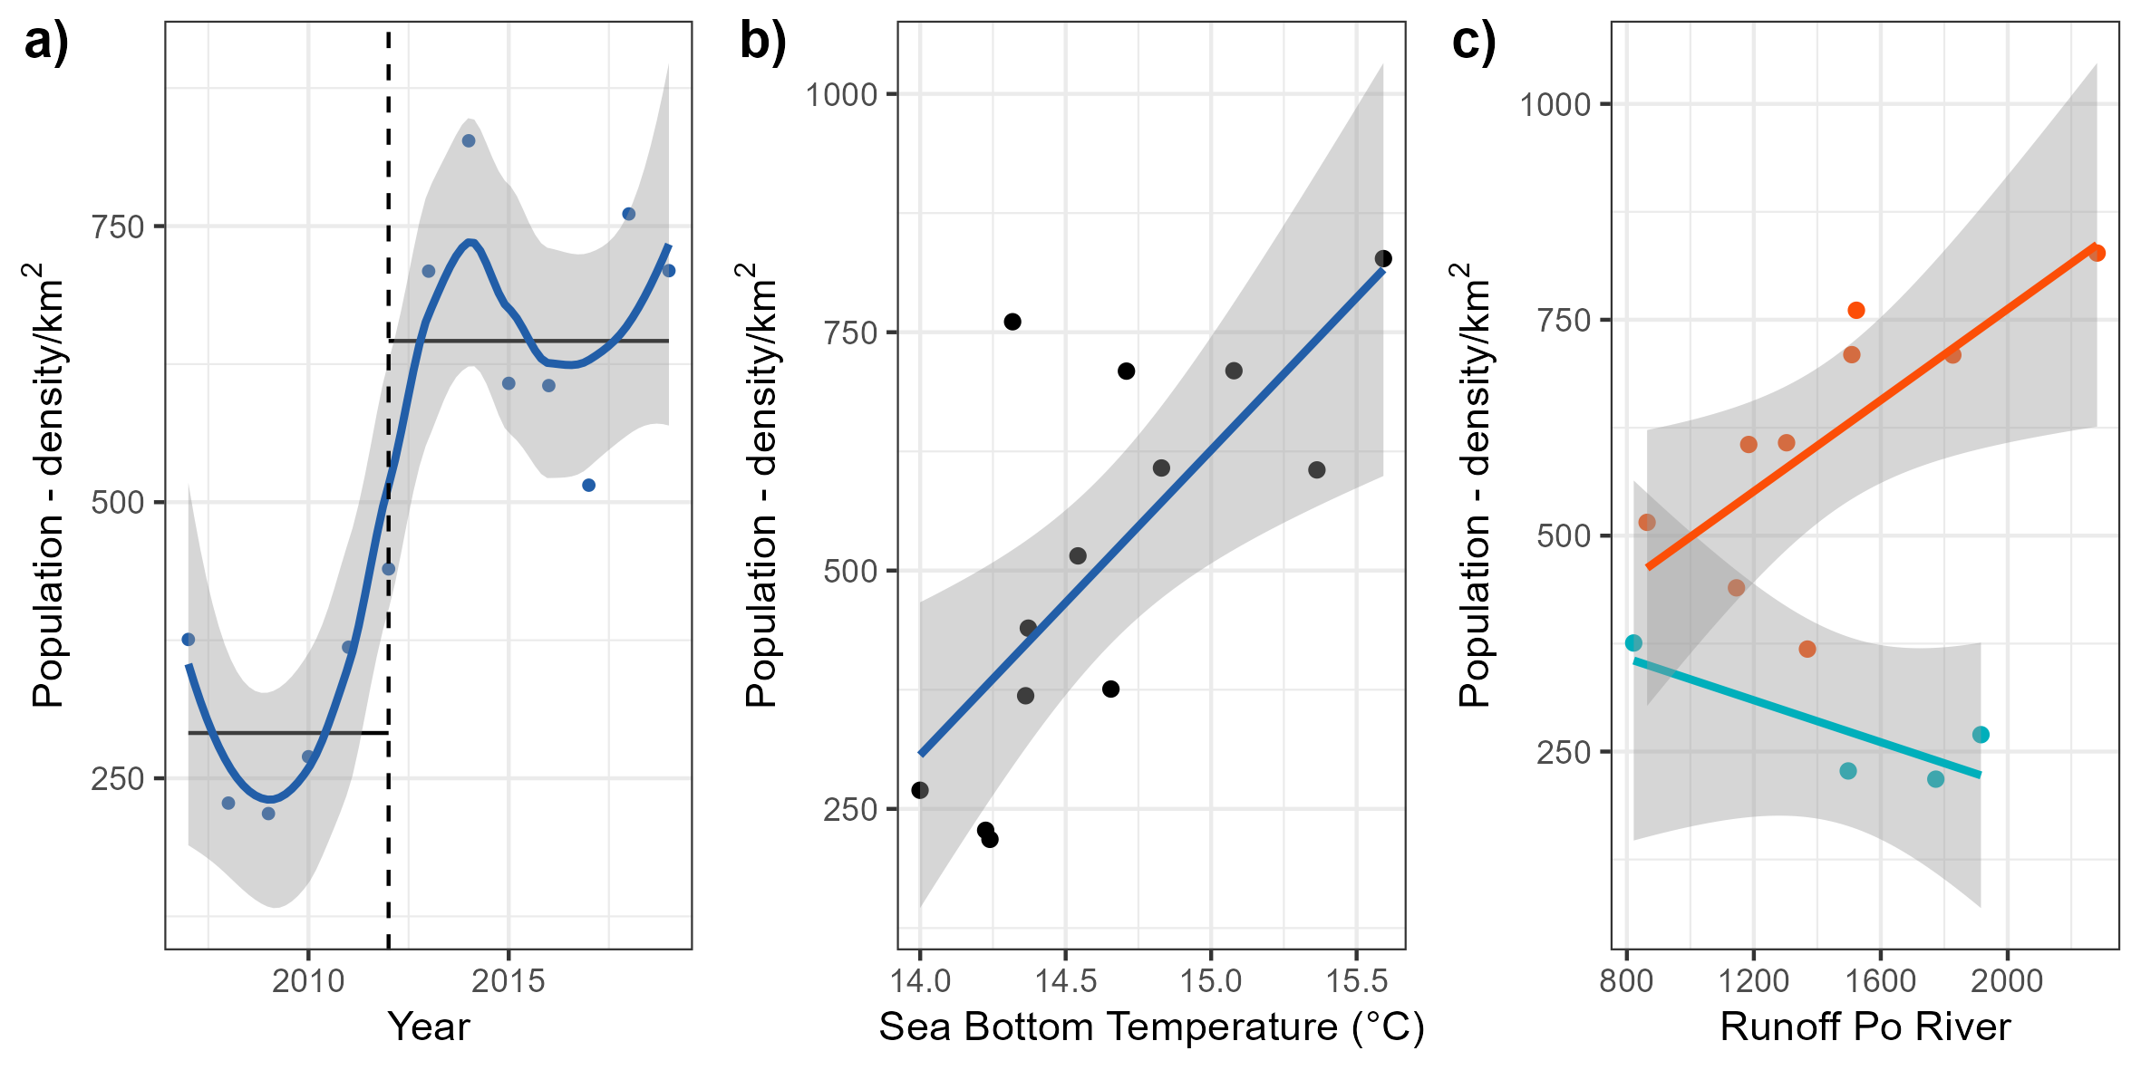
High
Low

Slide 10
